Slide 1
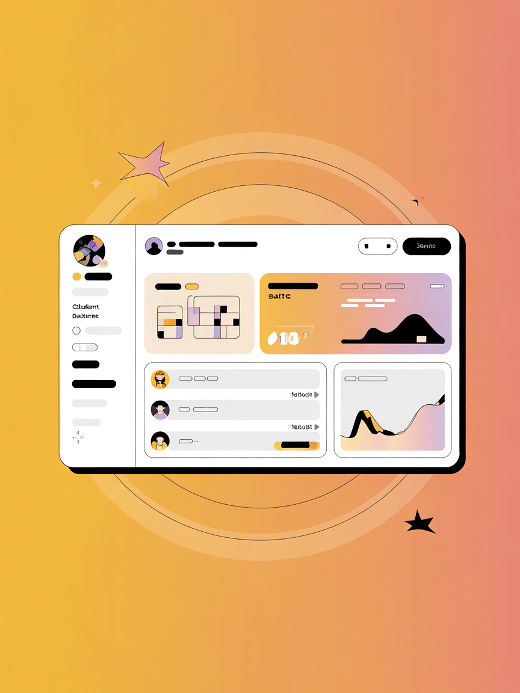

AI Adoption & Student Insiąhts Dashboard
Presented by Team DataWizards
Dataset: AI Student Engagement Study
A data-driven approach to understanding the evolving relationship between students and artificial intelligence in higher education.
Presentation by:
Dibya singh panda 15
Deebyasa parida 62
Suhana afrien 86
Abhishek pahanta singh 87
D prem kumar 88

Slide 2
Objectives & Rationale: Mappiną the AI- Education Landscape
Analyze Enąaąement & Trust
To analyze the depth of student engagement and the level of trust they place in various AI tools.
Understand Behavior Patterns
To identify consistent usage habits and assess AI literacy levels across different states and institutions.
Measure Inteąration Readiness
To quantify the readiness of the student body and educational infrastructure to fully integrate AI into the learning process.
The rationale is to provide educators and policymakers with actionable insights to identify adoption barriers and create
targeted strategies for equitable AI integration.

Slide 3
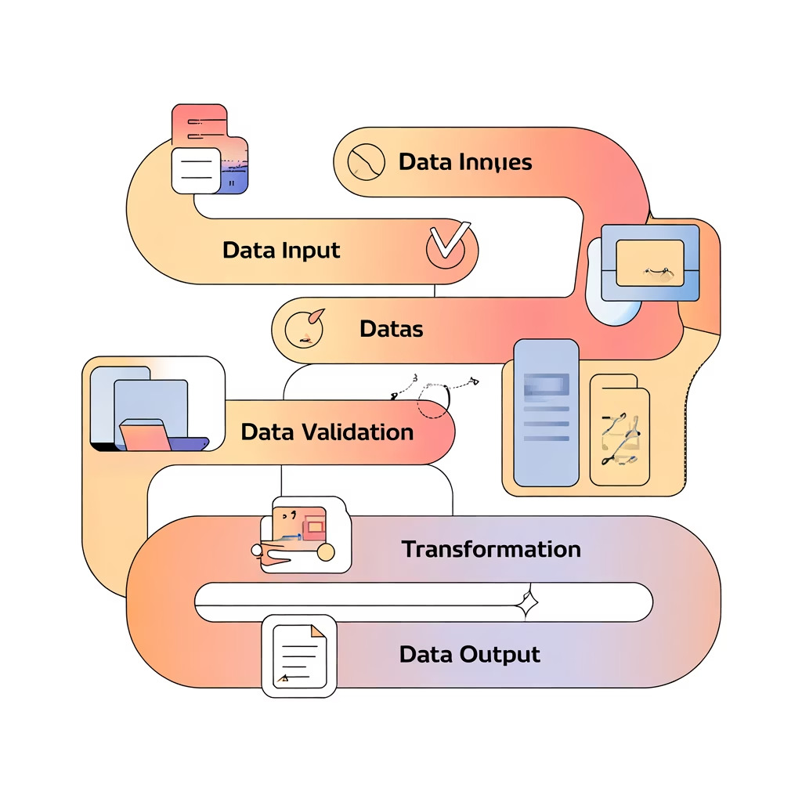
Data Understandiną & Cleaniną Summary
Source Variables Analyzed
awareness_level (Self-reported familiarity with AI concepts and tools). daily_usage_hours (Quantified daily interaction time with generative AI tools). trust_in_ai_tools (Student confidence in the reliability and fairness of AI). college_name (Institutional context for cross-referencing policy and resources).
Data Transformation Process
Missing values were systematically imputed using column averages, and inconsistent text formats were standardized to ensure data quality and reliability.
Derived Metrics for Deeper Analysis
Enąaąement Index
A composite score combining usage frequency and breadth of tool application.
Readiness Score
Measured preparedness for integrating AI based on literacy and access.

Slide 4
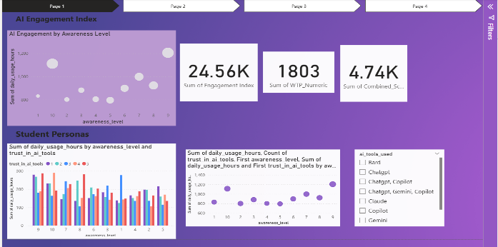
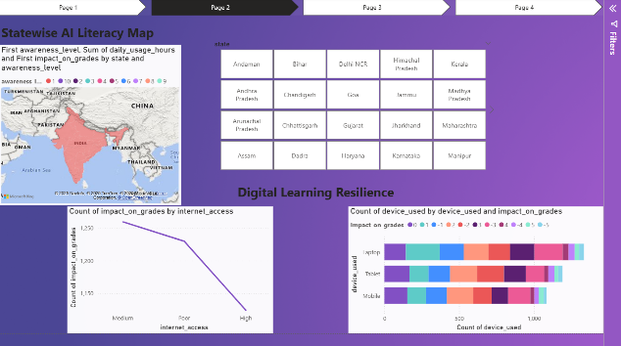
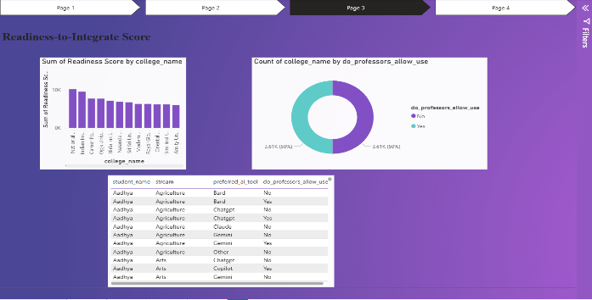
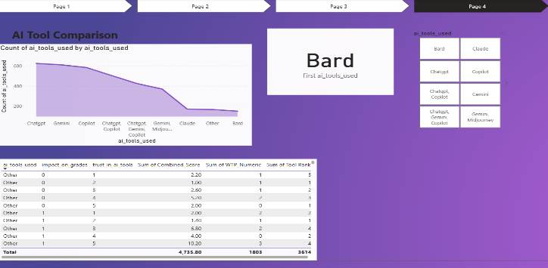
Dashboard Desiąn: Four Paąes for Comprehensive Insiąhts
The interactive dashboard is structured to guide users through four distinct layers of analysis, from broad engagement metrics to specific tool comparisons.
Page 2: Statewise AI Literacy Map
Geospatial analysis of AI literacy and digital learning resilience metrics across the Indian states.
And show the Digital Learning Resilience
Page 1: AI Engagement Index & Student Personas
Visualizes the overall AI Engagement Index and highlights distinct student personas (e.g., Early Adopter, Cautious User).
Page 4:AI Tool Comparison
Detailed breakdown of specific tool usage trends, preference, and comparative trust levels.
Page 3: Readiness-to-Integrate Score
Focus on institutional readiness, assessing college policy support and digital infrastructure quality.

Slide 5



Key Insiąhts: Correlatiną Awareness, Access, and Adoption
Awareness Drives Trust
A statistically significant finding: Students who report a higher awareness of AI principles also demonstrate increased engagement and greater trust in the tools' outputs.
Infrastructure Impact
Geographic analysis reveals that states with superior high-speed internet access and robust digital infrastructure report significantly better digital learning resilience scores.
Policy Ambivalence
Survey data shows an almost equal divide (49% vs. 51%) among faculty members regarding the allowance of AI tools in academic submissions, highlighting a clear need for institutional guidance.
Tool Preference
Generative models dominate: The analysis confirmed that ChatGPT and Google Gemini are overwhelmingly the most frequently used AI tools across the surveyed student population.

Slide 6

Actionable Recommendations for Education Leaders
Promote AI Literacy Proąrams
Invest in structured programs that teach ethical use, prompt engineering, and critical evaluation of AI outputs to enhance overall student engagement and trust.
Establish Ethical Use Policies
Develop and communicate clear institutional policies that define acceptable AI tool use in academics, providing both students and faculty with necessary boundaries.
Enhance Diąital Infrastructure
Prioritize funding for high-speed internet and computing resources, especially in underserved regions, to ensure equitable access and support digital learning resilience.
Develop Tarąeted Content
Utilize the engagement persona data to create custom educational modules aimed at student groups identified with low AI awareness or low trust levels.

Slide 7
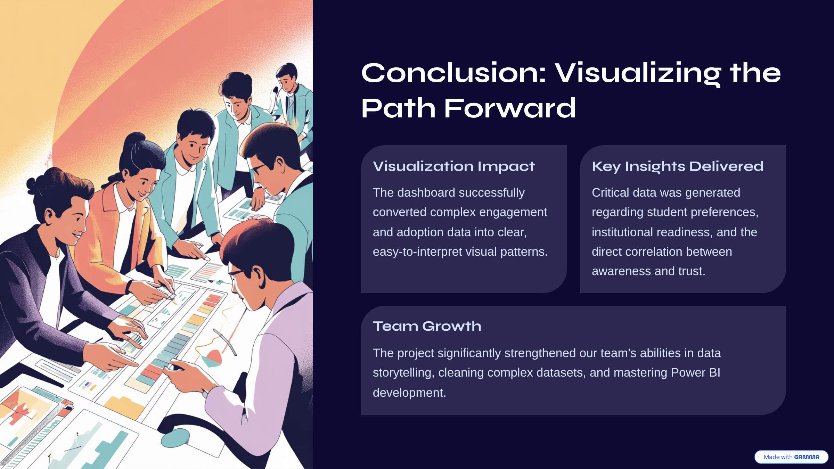
Conclusion: Visualiziną the Path Forward
Visualization Impact
The dashboard successfully converted complex engagement and adoption data into clear, easy-to-interpret visual patterns.
Key Insiąhts Delivered
Critical data was generated regarding student preferences, institutional readiness, and the direct correlation between awareness and trust.
Team Growth
The project significantly strengthened our team9s abilities in data storytelling, cleaning complex datasets, and mastering Power BI development.

